Slide 1
Fire Alarm System
Project Proposal
IOT Course
By: Mansoor Ahmad
Supervisor: Dr. Chayakorn Netramai
27th Feb, 2023

Slide 2
Contents
Problem Statement
Generic Solution Architecture
Use Case I (Sensor Based)
Software Flow Chart
Hardware Flow Diagram
Use Case II (Camera Based)
Software Flow Chart
Hardware Flow Diagram
Hardware Requirements
Deliverables
Timeline
References

Slide 3
Problem Statement
Lack of timely fire prediction in
Indoors / Warehouses / Data Centers
Forests / Mountains
Reasons for unnoticed fires
Human unavailability
Hardware Limitations
No remote notifications
Results of late knowledge
Uncontrolled Fire
Lose of lives
Lose of infrastructure

Slide 4
Generic Solution Architecture
Cloud
Mobile
Air Quality Sensor
Arduino
Raspberry π
Buzzer
Camera

Slide 5
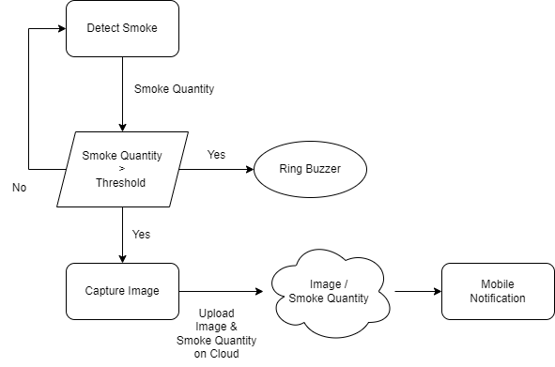
Use Case I (Sensor-based)
- Software Flow Chart

Slide 6
Use Case I (Sensor-based)
- Hardware Flow Diagram
Cloud
Mobile
7.
6.
Upload Image
And smoke
quantity
View smoke
quantity
and visuals
1.
Continuous
sensing
3.
Capture image
(if smoke detected)
Air Quality Sensor
Arduino
(compare smoke threshold)
Raspberry π
5.
Image File
2.
Switch-On buzzer
on smoke
above threshold
Buzzer
4.
Camera
Take
snapshot
on request

Slide 7
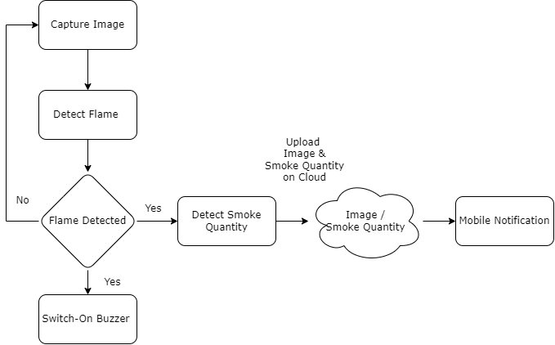
Use Case II (Camera-based)
- Software Flow Chart

Slide 8
Use Case II (Camera-based)
- Hardware Flow Diagram
Cloud
Mobile
7.
6.
Upload Image
And smoke
quantity
View smoke
quantity
and visuals
4.
Detect
Smoke
Air Quality Sensor
Arduino
3.
Detect Smoke
Raspberry π
(flame detection)
2.
Image File
5.
Switch-On buzzer
on smoke
above threshold
Buzzer
1.
Take
snapshot
on request
Camera

Slide 9
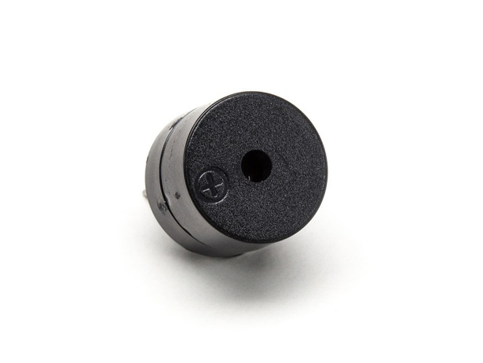
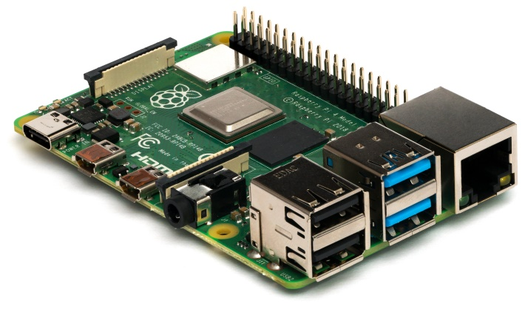
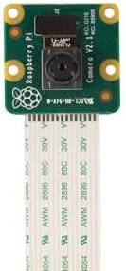
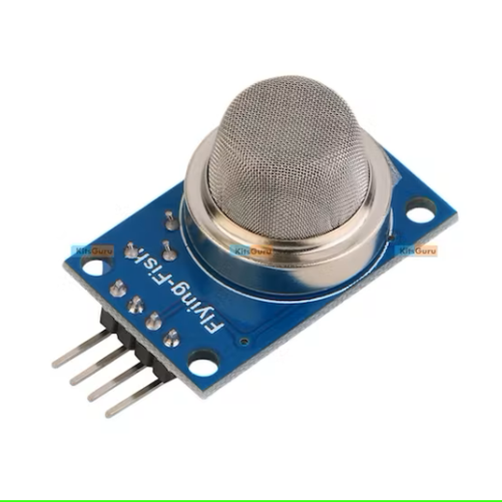
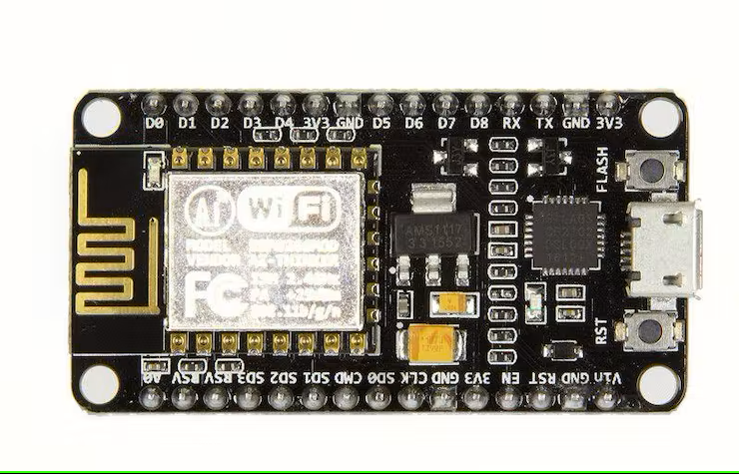
Hardware Requirements
ESP8266 NodeMCU
Raspberry Pi
Smoke Sensor
Buzzer
Camera

Slide 10
Deliverables
Netpi Dashboard
Mobile Notification App
Arduino Code
Raspberry Pi Code
Working Use Case I
Working Use Case II (Optional)

Slide 11
Timeline
Date | Week | Task | Total Score | Obtained Score | Additional Information
 | 1 | Detect Smoke
 | 2 | Sound Buzzer
 | 3 | Capture Image
 | 4 | Connect Raspberry Pi & Arduino
 | 5 | Create Cloud Dashboard
 | 6 | Send Data to Cloud
 | 7 | Mobile Notification
 | 8

Slide 12
References
https://circuitdigest.com/microcontroller-projects/iot-based-forest-fire-detection-using-arduino-and-gsm-module
https://projecthub.arduino.cc/ayanfeoluwaadekanye1/e4d081ac-3a48-4446-9656-3a8c1c0845ec
https://maker.pro/arduino/projects/iot-smoke-alarm-arduino-esp8266-gas-sensor
https://microcontrollerslab.com/iot-fire-detection-esp32-flame-sensor-email-alert/
https://www.hackster.io/1NextPCB/iot-based-fire-alarm-system-using-nodemcu-esp8266-226aa3

